Slide 2
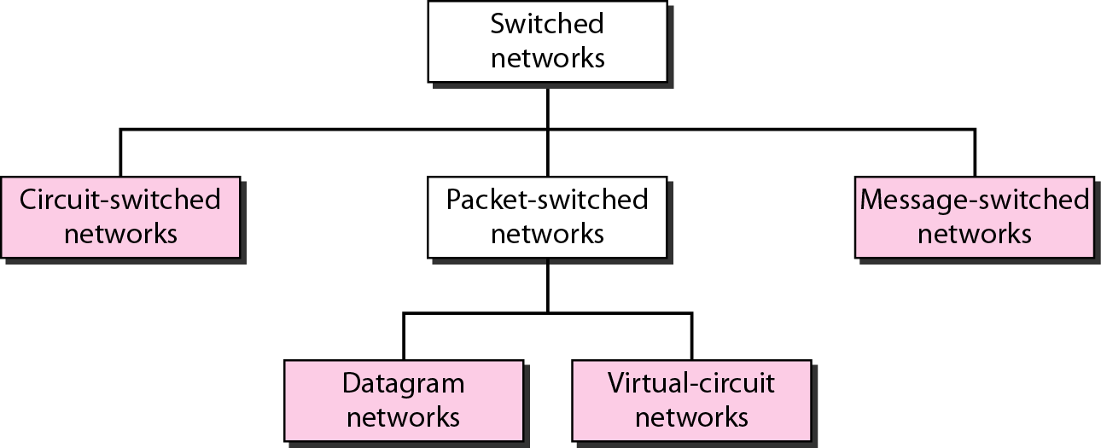
Switched Network Categories

Slide 3
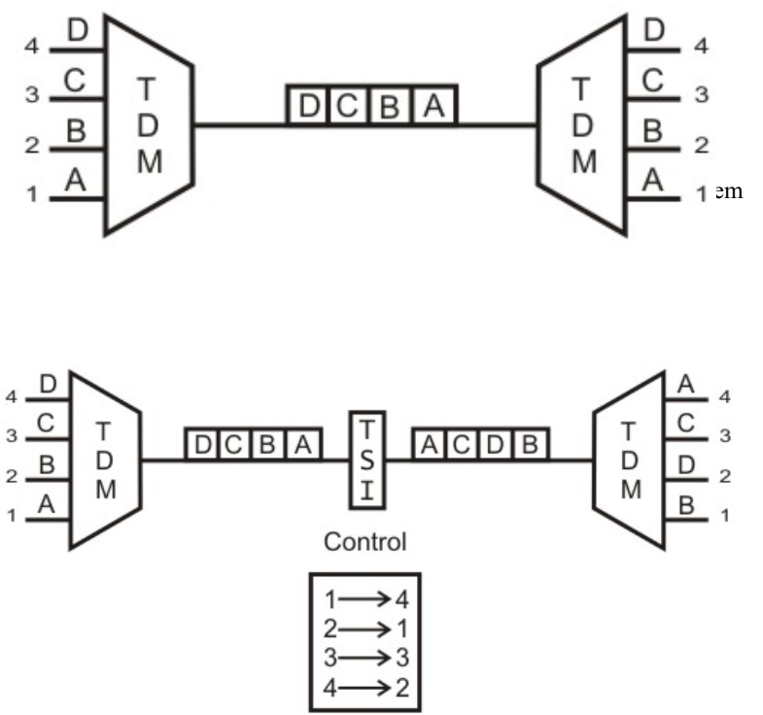
Time Division Switching
Same switch transmits both voice an data as digital signals
Modern circuit switches use digital TDM technique
Synchronous TDM allows multiple low-speed bit streams to share a high-speed line.
Sampled in a round robin manner.
The samples are organized serially into slots (channels) to form a recurring frame of slots.

Slide 4
Time Division Switching
During successive time slots, different I/O pairings are enabled, allowing a number of connections to be carried over the shared bus.
Data rate on the bus must be high enough so that the slots recur sufficiently frequently.
The source-destination pairs corresponding to all active connections are stored in control memory.
Thus the slots need not specify the source and destination addresses.

Slide 5
Time Division Switching
Time-division switching uses TDM to achieve switching, i.e. different ongoing connections can use same switching path but at different interleaved time intervals.
There are two popular methods of time-division switching namely,
Time-Slot Interchange (TSI)
TSI changes the ordering of the slots based on desired connection and it has a random-access memory to store data and flip the time slots.
Writing can be performed in the memory sequentially, but data is read selectively.
TDM bus
In TDM bus there are several input and outputs connected to a high-speed bus.
During a time slot only one particular output switch is closed, so only one connection at a particular instant of time.

Slide 6
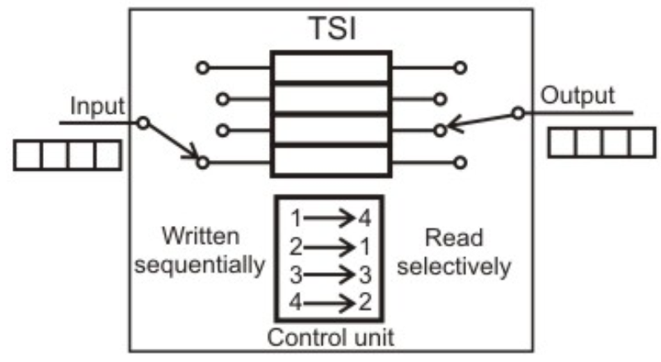
Time-Slot Interchange (TSI)

Slide 7
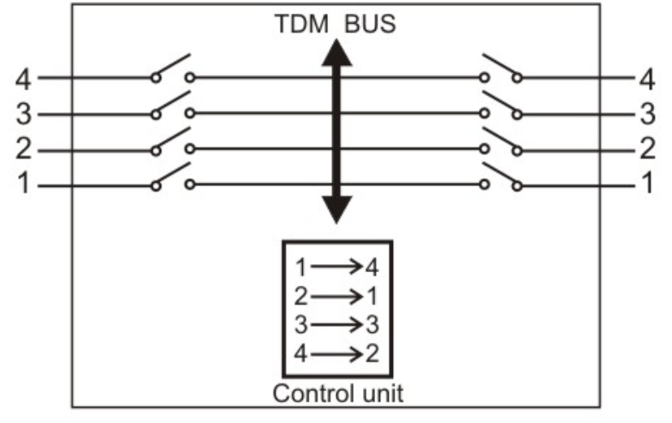
TDM bus

Slide 8
Public Switched Telephone Networks
PSTN is an example of circuit-switched network.
Also known as Plain Old Telephone Service (POTS).
The switching centres used for the switching are organised in different levels, namely:
Regional offices (class 1),
Section offices (class 2),
Primary offices (class 3),
Toll offices (class 4) and finally
End offices (class 5)
Subscribers are directly connected to these end offices.
Each office is connected directly to a number of offices at a level below and mostly a single office at higher level.

Slide 9
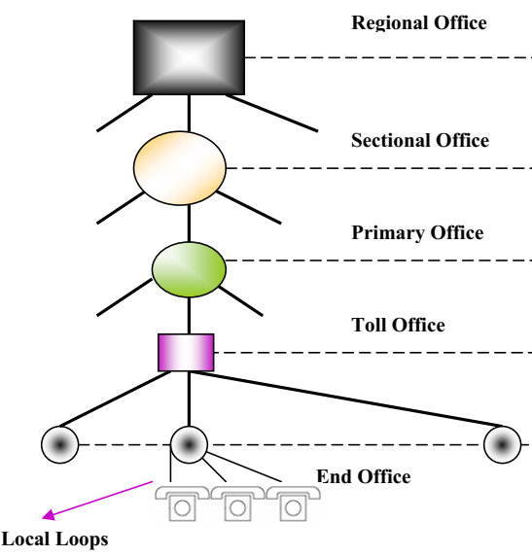
PSTN

Slide 10
PSTN
Subscriber Telephones are connected, through Local Loops to end offices (or central offices).
A small town may have only one end office, but large cities have several end offices.
All regional offices are connected using mesh topology.
Accessing the switching station at the end offices is accomplished through dialling.
In the past, telephone featured rotary or pulse dialling, in which digital signals were sent to the end office for each dialled digit.
prone to errors due to inconsistency in humans during dialling

Slide 11
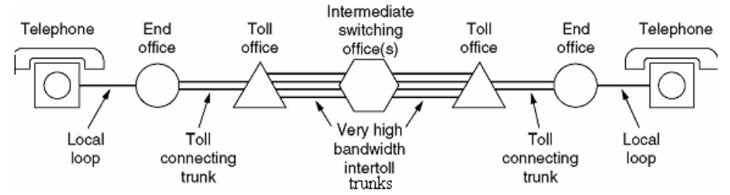
PSTN
Solution:
dialling by Touch-Tone technique.
Touch-Tone technique:
User sends a small burst of frequency called dual tone, because it is a combination of two frequencies.
This combination of frequencies sent depends on the row and column of the pressed pad.
The connections are multiplexed when have to send to an upward switching office.

Slide 12
Issues with Circuit Switching
It satisfies the requirement of voice communication, it suffers from the following two shortcomings for data communication:
In a typical user/host data connection, line utilization is very low.
Provides facility for data transmission at a constant rate
For information transmission applications, the circuit switching method is very slow, relatively expensive and inefficient.
Establishing a dedicated connection before sending the message itself inserts a delay time, which might become significant for the total message transfer time.
Total channel remains idle and unavailable to the other users once connection is made.

Slide 13
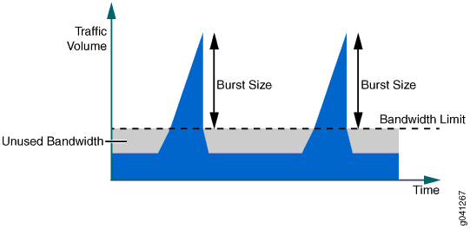
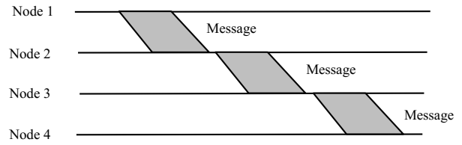
Issues with Circuit Switching
Once a connection is established, it is guaranteed and orderly delivery of message is ensured.
Unfortunately, the data transmission pattern may not ensure this, because data transmission is bursty in nature which limits the utility of the method.
Solution:
Message Switching .

Slide 14
Message Switching
No dedicated physical line between the sender and receiver
Message is sent to the nearest directly connected switching node.
This node stores the message, checks for errors, selects the best available route and forwards the message to the next intermediate node.
The line becomes free again for other messages, while the process is being continued in some other nodes.
Known as store-and-forward technology where the message hops from node to node to its final destination.

Slide 15
Message Switching: Advantages
More devices can share the network bandwidth.
Temporary storage of message reduces traffic congestion to some extent.
Urgency of messages are considered leading to faster transmission of urgent messages
Through broadcast addresses one message can be sent to several users.
Since the destination host need not be active when the message is sent, global communication is improved.

Slide 16
Message Switching: Disadvantages
Large message blocks requires considerable amount of storage space at each node to buffer the messages.
A message might occupy the buffers for minutes, thus blocking the inter-nodal traffic.
Solution:
Packet Switching

Slide 17
Packet Switching
Follows same ‘store-and-forward’ approach.
To overcome the limitations of message switching, messages are divided into subsets of equal length called packets.
This approach was developed for long-distance data communication (1970) and it has evolved over time.
In packet switching approach, data are transmitted in short packets (few Kbytes).
A long message is broken up into a series of packets.
Every packet contains some control information in its header, which is required for routing and other purposes.

Slide 18
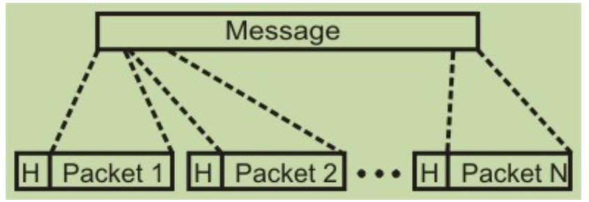
Packet Switching

Slide 19
Packet Switching
Main difference with Circuit Switching
communication lines are not dedicated to passing messages from the source to the destination.
Different messages (and even different packets) can pass through different routes
“Dead time" in communication between the source and the destination, can be used by other sources.
Two types:
Datagram Network
Virtual Circuit Switched Network

Slide 20
Datagram Network
No reserved bandwidth on the links, and
No scheduled processing time for each packet.
Resources are allocated on demand on a FCFS basis.
When a switch receives a packet, irrespective of source or destination, the packet must wait if other packets are being processed which create delay.
Each packet is treated independently.
Even if a packet is part of a multi-packet transmission, the network treats it as though it existed alone.
Packets in this approach are referred to as datagrams.

Slide 21
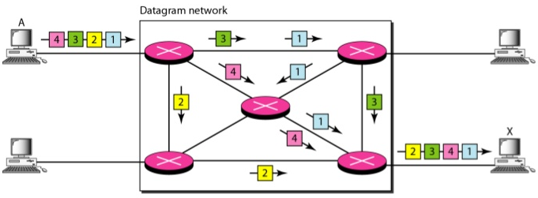
Datagram Network

Slide 22
Datagram Network
Links may be not have the necessary bandwidth available to carry all the packets from A to X.
Out of order arrival at destination with different delays between the packets.
Packets may also be lost or dropped because of a lack of resources.
In most protocols, it is the responsibility of an upper-layer protocol to reorder the datagrams or ask for lost datagrams before passing them on to the application.

Slide 23
Datagram Network
Datagram networks are sometimes referred to as connectionless networks.
No setup or teardown phases.
Each packet is treated the same by a switch regardless of its source or destination.
The efficiency is better than that of a circuit-switched network
Resources are allocated on demand.
If a source sends a packet and there is a delay before another packet can be sent, the resources can be reallocated during this delay for other packets from other sources.

Slide 24
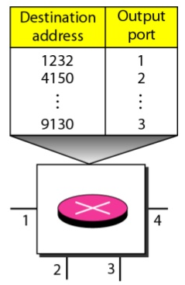
Routing Table maintained by Intermediate Nodes
Every packet carries a header that contains, the destination address of the packet.
When the switch receives the packet, this destination address is examined; the routing table is consulted to find the corresponding port through which the packet should be forwarded.
This address, remains the same during the entire journey of the packet.

Slide 25
Datagram Network
Greater delay than in a virtual-circuit network.
Although there are no setup and teardown phases, each packet may experience a wait at a switch before it is forwarded.
In addition, since not all packets in a message necessarily travel through the same switches, the delay is not uniform for the packets of a message.

Slide 26
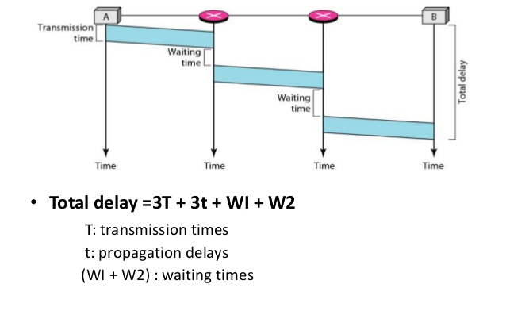
Delay in Datagram Network

Slide 27
VIRTUAL-CIRCUIT NETWORKS
Cross between a circuit-switched network and a datagram network
As in a circuit-switched network, setup, teardown and data transfer phase.
Resources can be allocated during the setup phase, or on demand
Data are packetized and each packet carries an address in the header. However, the address in the header has local jurisdiction (it defines what should be the next switch and the channel on which the packet is being carried), not end-to-end jurisdiction.
Maintains virtual-circuit identifiers
All packets follow the same path established during the connection.
Normally implemented in the data link layer, while a circuit-switched network is implemented in the physical layer and a datagram network in the network layer.

Slide 28
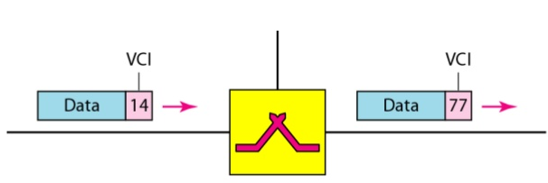
VIRTUAL-CIRCUIT NETWORKS: Addressing
Global Addressing
A source or a destination needs to have a global address
Unique in the scope of the network (nationally or internationally)
a global address in virtual-circuit networks is used only to create a virtual-circuit identifier.
Virtual-Circuit Identifier
The identifier that is actually used for data transfer is called the virtual-circuit identifier (VCl).
A VCI, unlike a global address, is a small number that has only switch scope;
It is used by a frame between two switches.
When a frame arrives at a switch, it has a VCI; when it leaves, it has a different VCl.
A VCI does not need to be a large number since each switch can use its own unique set of VCls.

Slide 29
Connection of Virtual Circuit Networks: Data Transfer Phase
To transfer a frame from a source to its destination, all switches need to have a table entry for this virtual circuit.
The table, in its simplest form, has four columns, i.e., the switch holds four pieces of information for each virtual circuit that is already set up.
Assuming that each switch has a table with entries for all active virtual circuits.

Slide 30
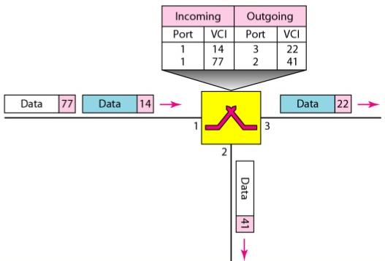

Slide 31
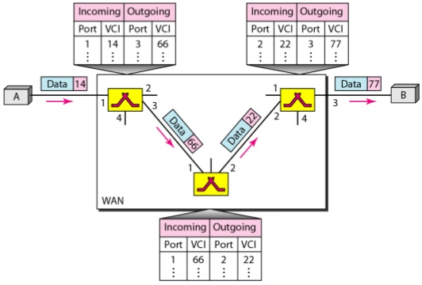

Slide 32
Connection of Virtual Circuit Networks: Setup Phase
A switch creates an entry for a virtual circuit.
For example, suppose source A needs to create a virtual circuit to B.
Two steps are required:
the setup request and
the acknowledgment

Slide 33
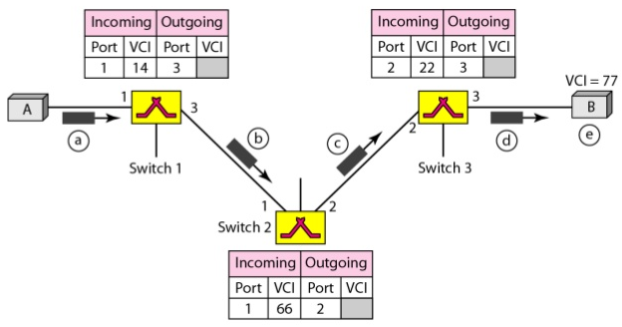
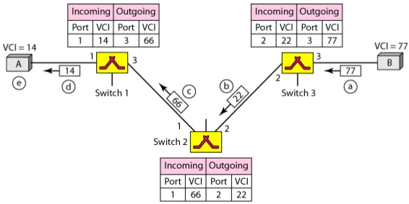

Slide 34
A setup request frame is sent from the source to the destination.
Source A sends a setup frame to switch 1.
Switch 1 receives the setup request frame. It knows that a frame going from A to B goes out through port 3. (How? To be covered later)
The switch, in the setup phase, acts as a packet switch; it has a routing table which is different from the switching table.
For the moment, assume that it knows the output port.
The switch creates an entry in its table for this virtual circuit, but it is only able to fill three of the four columns. It does not yet know the outgoing VCI, which will be found during the acknowledgment step. The switch then forwards the frame through port 3 to switch 2.

Slide 35
A setup request frame is sent from the source to the destination.
Switch 2 receives the setup request frame. The same events happen here as at switch 1; three columns of the table are completed: in this case, incoming port (l), incoming VCI (66), and outgoing port (2).
Switch 3 receives the setup request frame. Again, three columns are completed: incoming port (2), incoming VCI (22), and outgoing port (3).
Destination B receives the setup frame, and if it is ready to receive frames from A, it assigns a VCI to the incoming frames that come from A, in this case 77. This VCI lets the destination know that the frames come from A, and not other sources.

Slide 36
Connection of Virtual Circuit Networks: Acknowledgment
A special frame, called the acknowledgment frame, completes the entries in the switching tables.
The destination sends an acknowledgment to switch 3.
The acknowledgment carries the global source and destination addresses so the switch knows which entry in the table is to be completed.
The frame also carries VCI 77, chosen by the destination as the incoming VCI for frames from A.
Switch 3 uses this VCI to complete the outgoing VCI column for this entry.
Note that 77 is the incoming VCI for destination B, but the outgoing VCI for switch 3.

Slide 37
Connection of Virtual Circuit Networks: Acknowledgment
Note that 77 is the incoming VCI for destination B, but the outgoing VCI for switch 3.
Switch 3 sends an acknowledgment to switch 2 that contains its incoming VCI in the table, chosen in the previous step.
Switch 2 uses this as the outgoing VCI in the table.
Switch 2 sends an acknowledgment to switch 1 that contains its incoming VCI in the table, chosen in the previous step.
Switch 1 uses this as the outgoing VCI in the table.
Finally switch 1 sends an acknowledgment to source A that contains its incoming VCI in the table, chosen in the previous step.
The source uses this as the outgoing VCI for the data frames to be sent to destination B.

Slide 38
Connection of Virtual Circuit Networks: Teardown Phase
In this phase, source A, after sending all frames to B, sends a special frame called a teardown request.
Destination B responds with a teardown confirmation frame.
All switches delete the corresponding entry from their tables.

Slide 39
Efficiency
Resource reservation in a virtual-circuit network can be made during the setup or can be on demand during the data transfer phase.
In the first case, the delay for each packet is the same; in the second case, each packet may encounter different delays.
There is one big advantage in a virtual-circuit network even if resource allocation is on demand. The source can check the availability of the resources, without actually reserving it.
Consider a family that wants to dine at a restaurant. Although the restaurant may not accept reservations (allocation of the tables is on demand), the family can call and find out the waiting time. This can save the family time and effort.

Slide 40
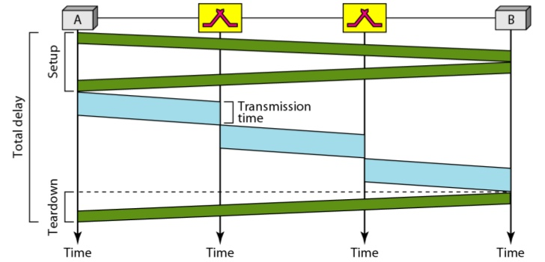
Delay
In a virtual-circuit network, there is a one-time delay for setup and a one-time delay for teardown.
If resources are allocated during the setup phase, there is no wait time for individual packets.
3T+3t+Setup+Teardown

Slide 41
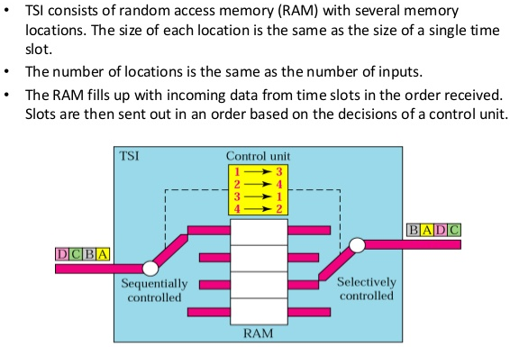
Time-Division Switch

Slide 42
Time- and Space-Division Switch Combinations
Space-division switching is instantaneous but huge number of crosspoints are required to make space-division switching acceptable in terms of blocking.
The advantage of time-division switching is that it needs no crosspoints.
Its disadvantage, in the case of TSI, is that processing each connection creates delays.
Each time slot must be stored by the RAM, then retrieved and passed on.
Combining the two results in switches that are optimized both physically (the number of crosspoints) and temporally (the amount of delay) provides better results.
Multistage switches of this sort can be designed as time-space-time (TST) switch.

Slide 43
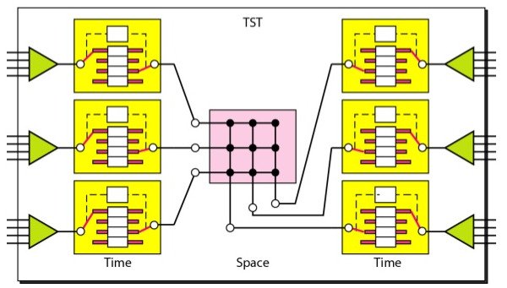
Time-Space-Time (TST) Switch

Slide 44
Time-Space-Time (TST) Switch
Instead of one time-division switch, it divides the inputs into three groups (of four inputs each) and directs them to three timeslot interchanges.
The result is that the average delay is one-third of what would result from using one time-slot interchange to handle all 12 inputs.
The last stage is a mirror image of the first stage.
The middle stage is a space division switch (crossbar) that connects the TSI groups to allow connectivity between all possible input and output pairs (e.g., to connect input 3 of the first group to output 7 of the second group)

Slide 45
Structure of Packet Switches
A switch used in a packet-switched network has a different structure from a switch used in a circuit-switched network.
We can say that a packet switch has four components:
input ports,
output ports,
the routing processor, and
the switching fabric

Slide 46
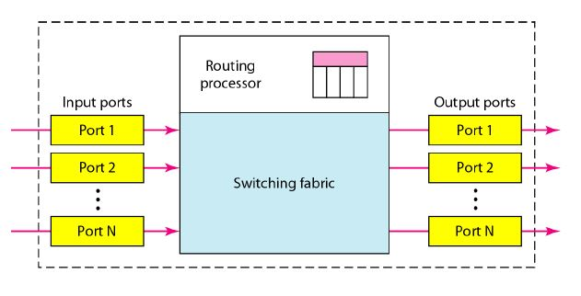
Structure of Packet Switches

Slide 47
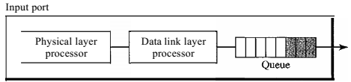
Structure of Packet Switches
Input Port :
Performs the physical and data link functions of the packet switch.
The bits are constructed from the received signal.
The packet is decapsulated from the frame.
Errors are detected and corrected.
The packet is now ready to be routed by the network layer.
In addition to a physical layer processor and a data link processor, the input port has buffers (queues) to hold the packet before it is directed to the switching fabric.

Slide 48
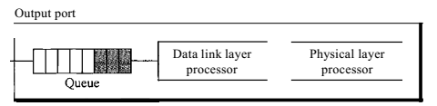
Structure of Packet Switches
Output Port:
The output port performs the same functions as the input port, but in the reverse order.
First the outgoing packets are queued, then the packet is encapsulated in a frame, and finally the physical layer functions are applied to the frame to create the signal to be sent on the line.

Slide 49
Structure of Packet Switches
Routing Processor:
The routing processor performs the functions of the network layer.
The destination address is used to find the address of the next hop and, at the same time, the output port number from which the packet is sent out.
This activity is sometimes referred to as table lookup because the routing processor searches the routing table.
In the newer packet switches, this function of the routing processor is being moved to the input ports to facilitate and expedite the process.

Slide 50
Structure of Packet Switches
Switching Fabrics:
The most difficult task in a packet switch is to move the packet from the input queue to the output queue.
The speed with which this is done affects the size of the input/output queue and the overall delay in packet delivery.
In the past, when a packet switch was actually a dedicated computer, the memory of the computer or a bus was used as the switching fabric.
The input port stored the packet in memory; the output port retrieved the packet from memory.
Today, packet switches are specialized mechanisms that use a variety of switching fabrics.

Slide 51
Structure of Packet Switches
Some of these fabrics are:
Crossbar Switch
Banyan Switch
A more realistic approach than the crossbar switch is the banyan switch (named after the banyan tree).
A banyan switch is a multistage switch with micro switches at each stage that route the packets based on the output port represented as a binary string.
For n inputs and n outputs, we have log2 n stages with nl2 micro switches at each stage.
The first stage routes the packet based on the high-order bit of the binary string.
The second stage routes the packet based on the second high-order bit, and so on.

Slide 52
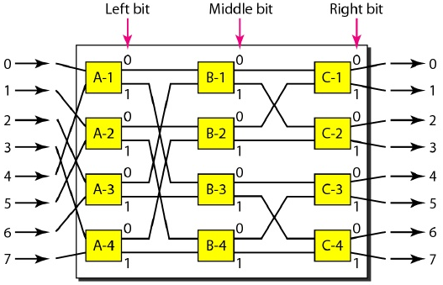
Banyan Switch

Slide 53
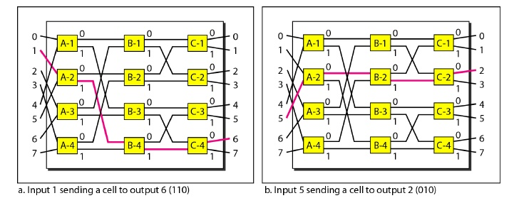

Slide 54
Batcher-banyan switch
The problem with the banyan switch is the possibility of internal collision even when two packets are not heading for the same output port.
We can solve this problem by sorting the arriving packets based on their destination port.
K. E. Batcher designed a switch that comes before the banyan switch and sorts the incoming packets according to their final destinations.
The combination is called the Batcher-banyan switch.
The sorting switch uses hardware merging techniques.
Normally, another hardware module called a trap is added between the Batcher switch and the banyan switch.
The trap module prevents duplicate packets (packets with the same output destination) from passing to the banyan switch simultaneously.
Only one packet for each destination is allowed at each tick; if there is more than one, they wait for the next tick.

Slide 55
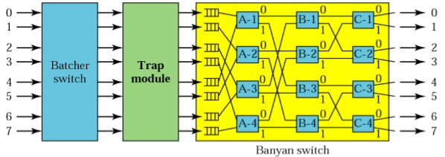
Batcher-banyan switch

Slide 56
Transmission Media
Using Telephone and Cable Networks for Data Transmission

